Slide 1
Predicting Bike Share due to Weather Forecast IE 7300 Statistical Learning for Engineers Project Overview By Group- 12
Abhijeeta Gupta
Vincenzo Coppola
Varun Vyas

Slide 2
Introduction
Problem Setting:
Bike sharing systems provide convenient and affordable way for residents to rent bikes, w/ automated rental processes and the ability to return bikes at different locations.
The growth of bike-sharing programs has been significant over the past decade, with over 3000 systems and 9 billion bikes offered globally as of 2021.
Bike-sharing programs help reduce carbon emissions and provide a healthier alternative to driving in large cities, but it is important to manage the growing demand and supply through data science techniques such as predicting demand
Problem Definition:
Objective: Predict hourly bike rental count using weather and seasonal forecast data from 2011-2012.
Techniques used: Machine learning algorithms including normalized and unpenalized regressions.
Data preparation: Cleaning and visualizing data to remove redundant columns and multicollinearity.

Slide 3
Data Description
The data provided consists of two datasets, one which consists of hourly rental bike counts and one daily counts
Data provided by University of Porto Portugal for the Capital bikeshare system during the period of 2011-2012
Data consists of time and weather-related variables (season, year, month, hour, holiday, weekday, working day, weather, and temperature)
The Hourly dataset intended for training contains 17389 records and 17 attributes, The daily dataset has 731 records and the same attributes aside from hour
The output or target variable of interest is the “cnt" attribute, representing the total number of rental bikes at that hour or day

Slide 4
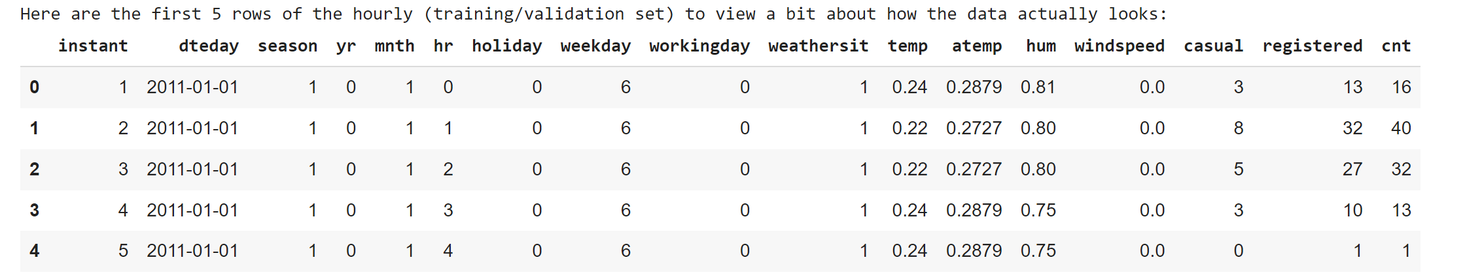
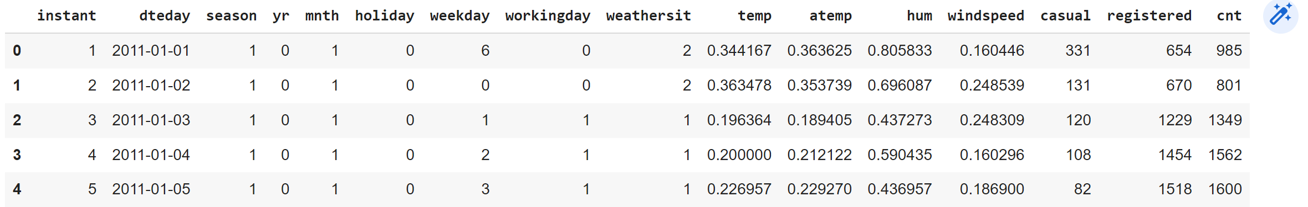
HOURLY (Main Training Dataset)
Daily (Testing and Alternate Training Dataset)

Slide 5
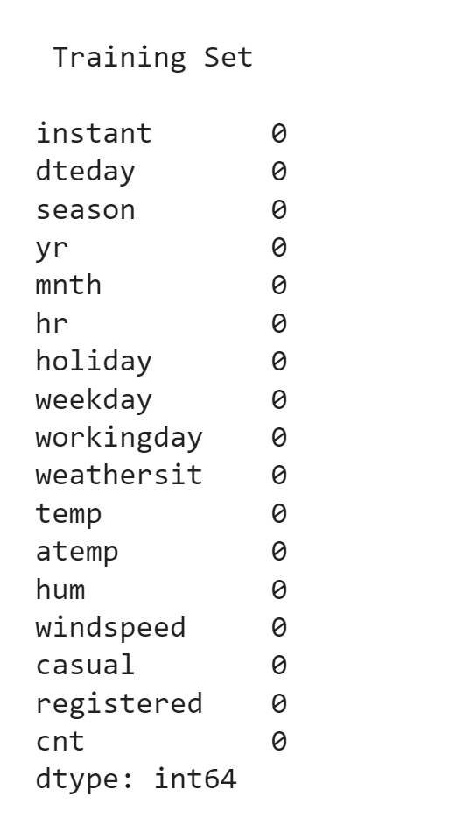
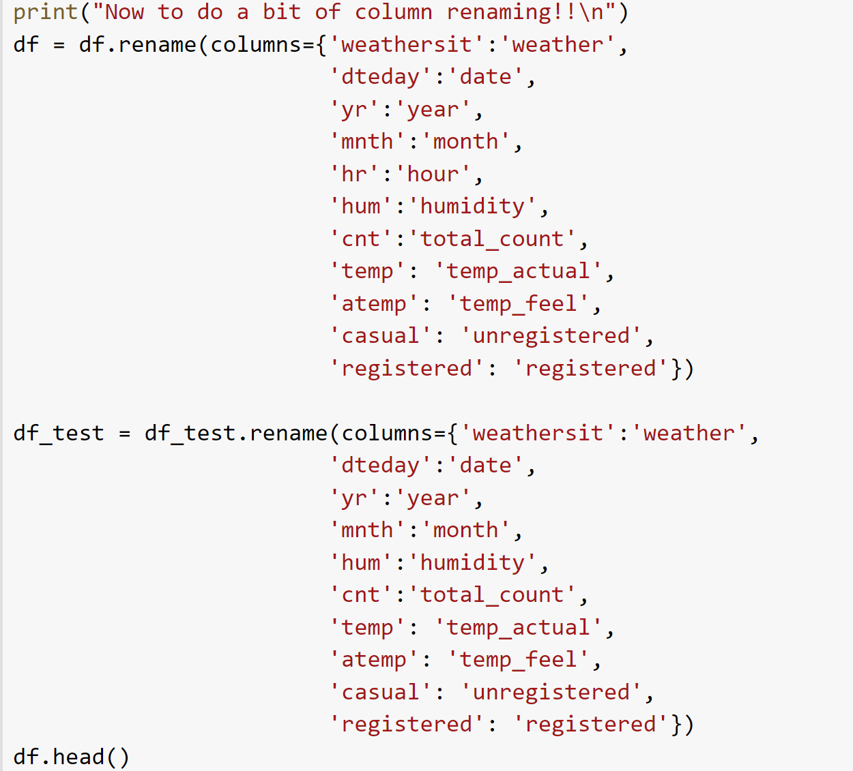
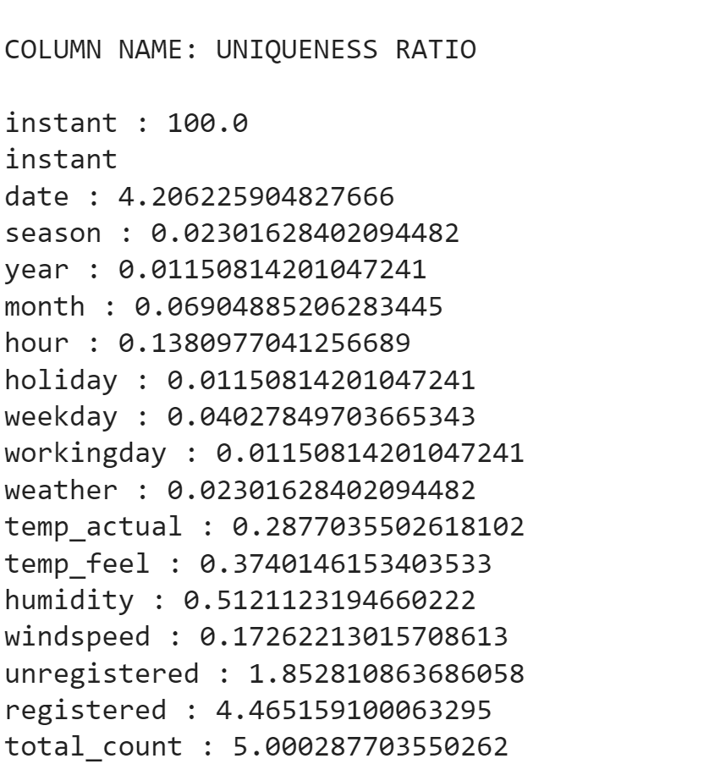
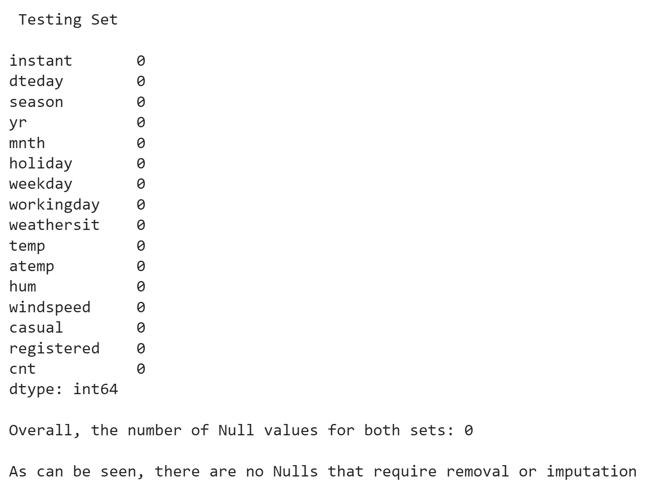
Data Preprocessing – Validation and Cleaning

Slide 6
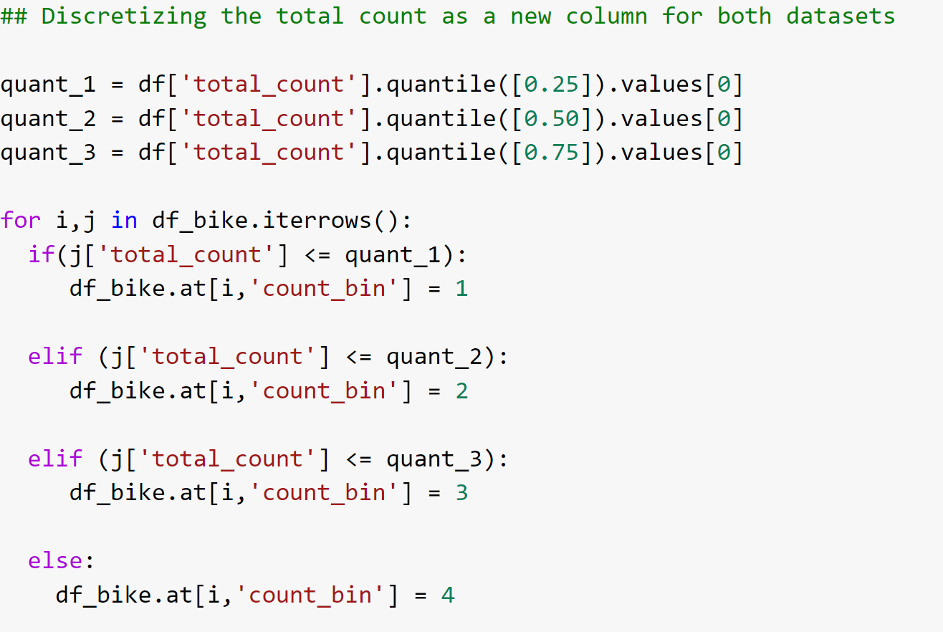
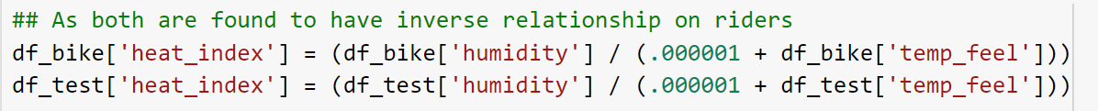
Data Preprocessing – Engineering
Count_bin: used mainly for visualizing
Heat_index: used for increasing dimensionality

Slide 7
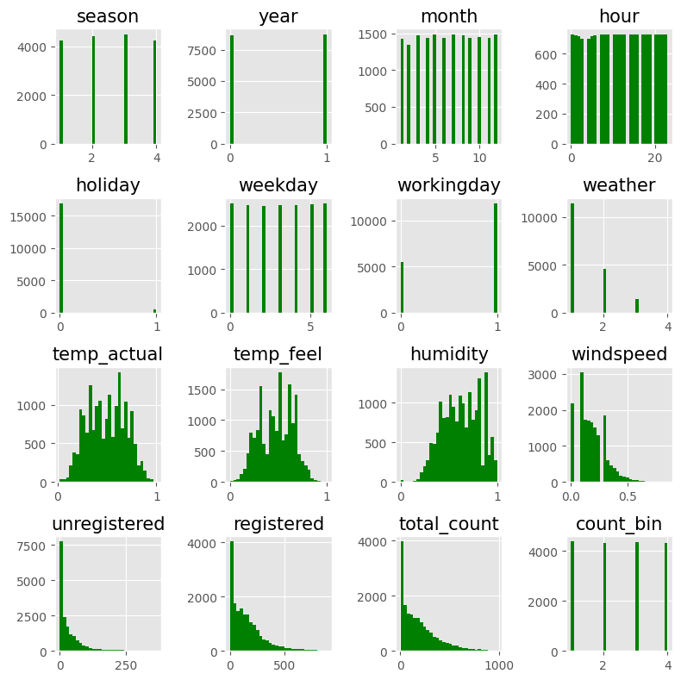
Exploratory Data Analysis:
Started by plotting histogram of all attributes to better understand each columns distributions

Slide 8
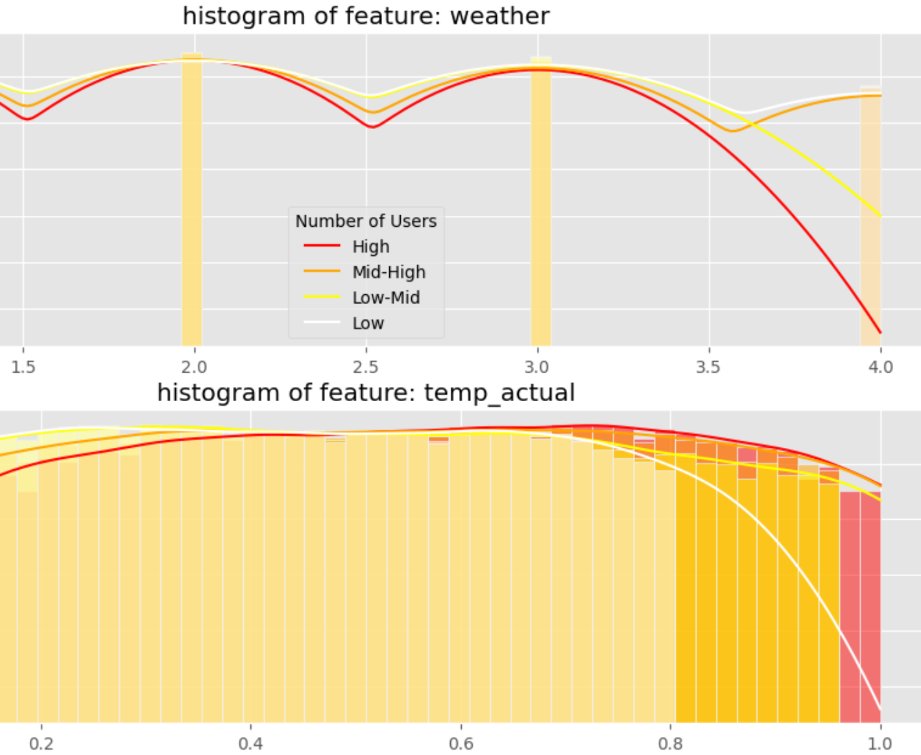
Continued EDA
Utilized engineered count_bin column to visualize how these attributes are distributed based on the target column level
Takeaways shown here:
As temperature increases, more records indicate high rentals
As weather worsens, more records indicate low rentals

Slide 9
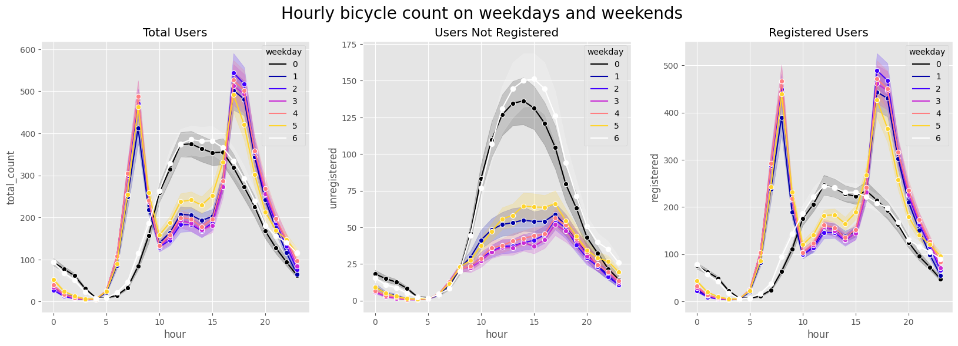
Understanding the variation of registered and unregistered users on hourly basis for weekdays and weekends
Hourly Visualization

Slide 10
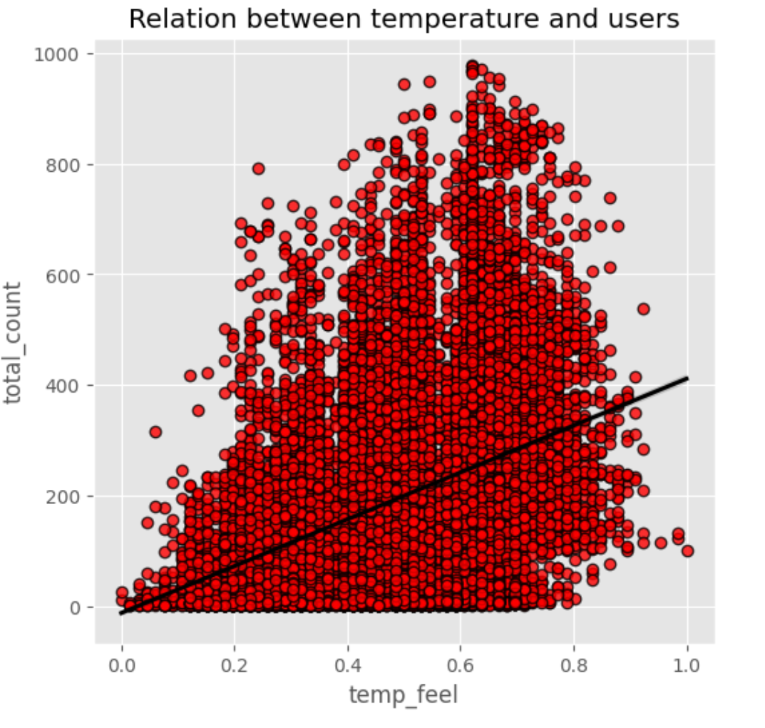
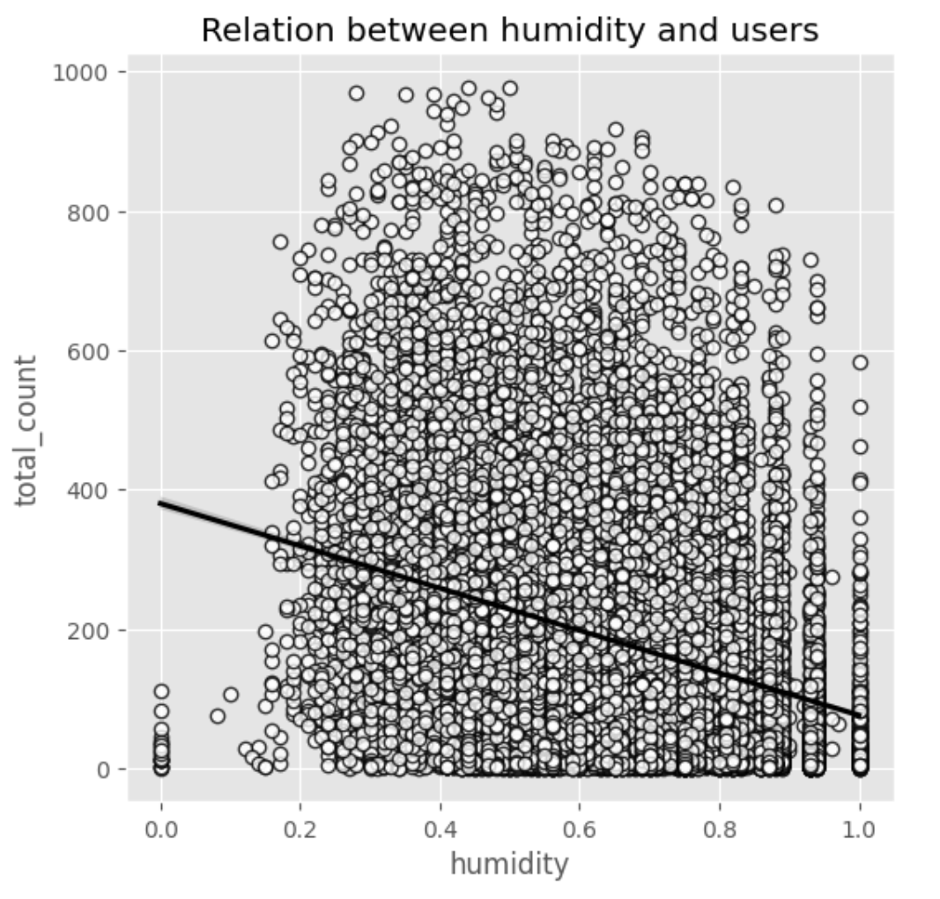
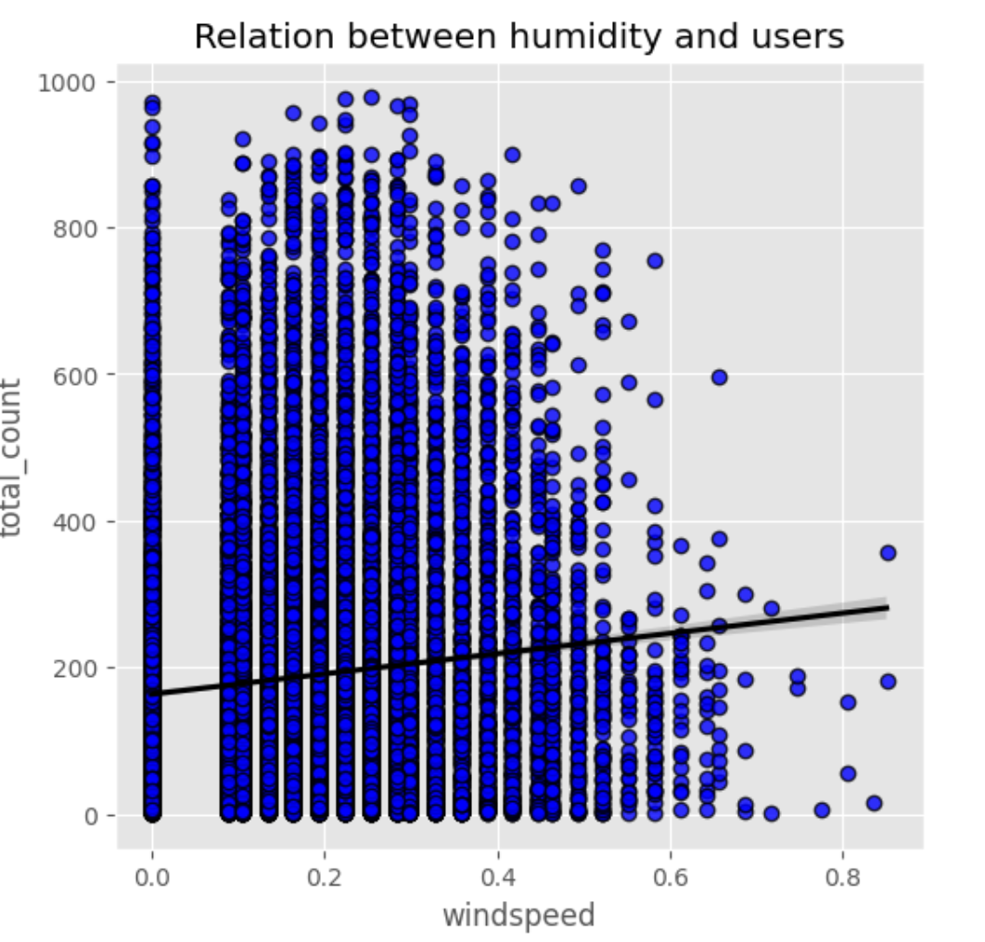
Understanding the relation between temperature, humidity & windspeed vs the users through regression plots Reasoning behind heat_index from previous slide
Windspeed and Users

Slide 11
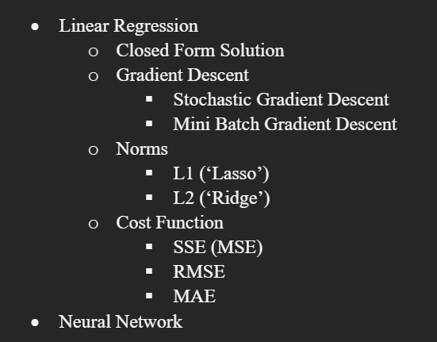
Methodologies Applied:

Slide 12

LINEAR REGRESSION
Creating a model to estimate the relationship between input and output variables
Gradient Descent and Closed Form Solution
Evaluating the accuracy of the model to ensure it is effective in predicting outcomes (even for other models)
Learning the weights of the descriptive hyperplane by Minimizing the error

Slide 13
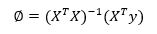
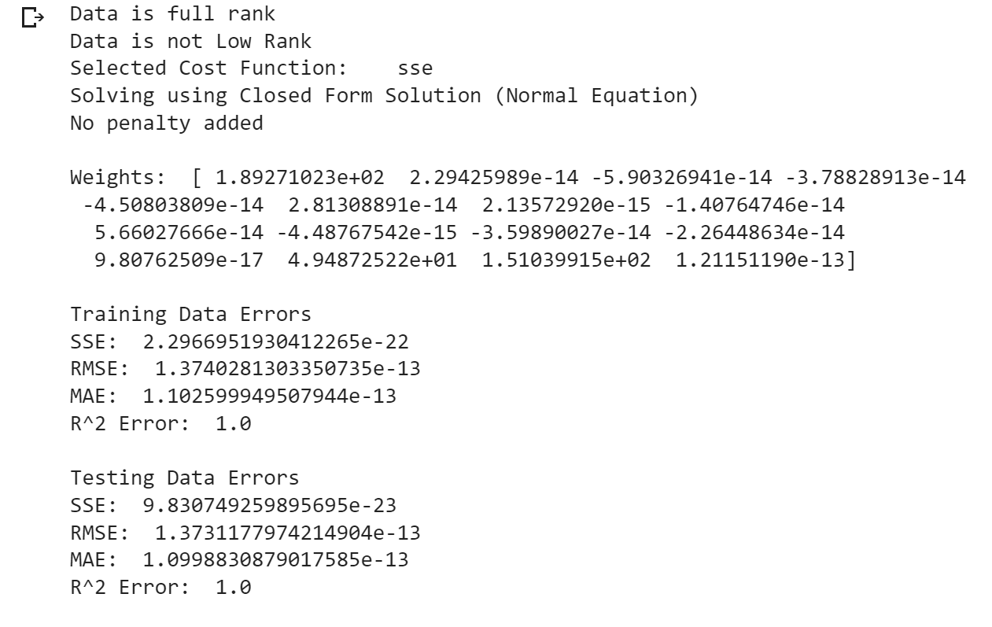
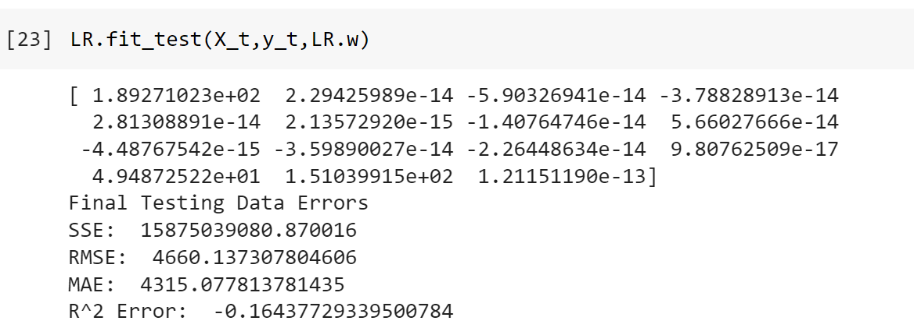
Building the Baseline
Using Closed Form!
Dataset Name | Description
Df_bike_baseline and Df_test_baseline | Datasets in their entirety
Df_bike_historical and Df_test_historical | Dataset without multicollinearities
Df_bike_limited and Df_test_limited | The bare minimum information (Time and Weather)

Slide 14
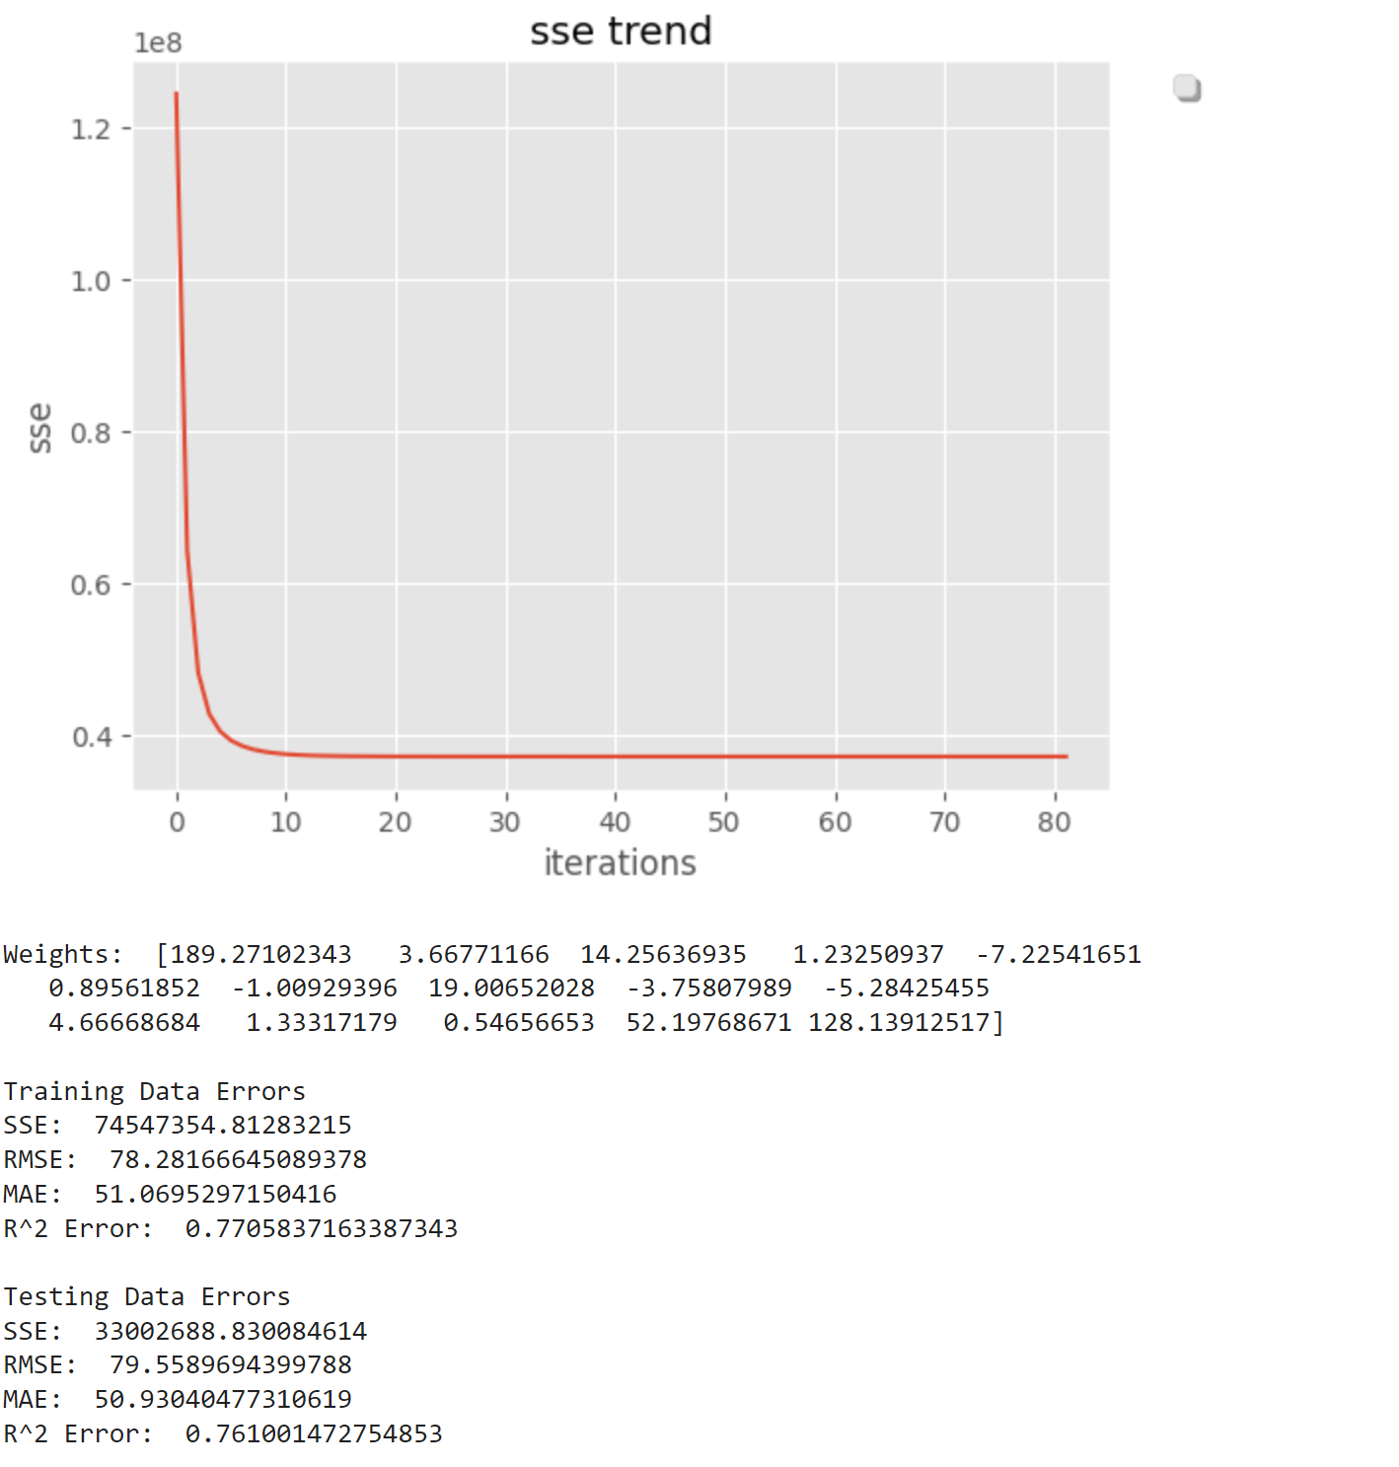
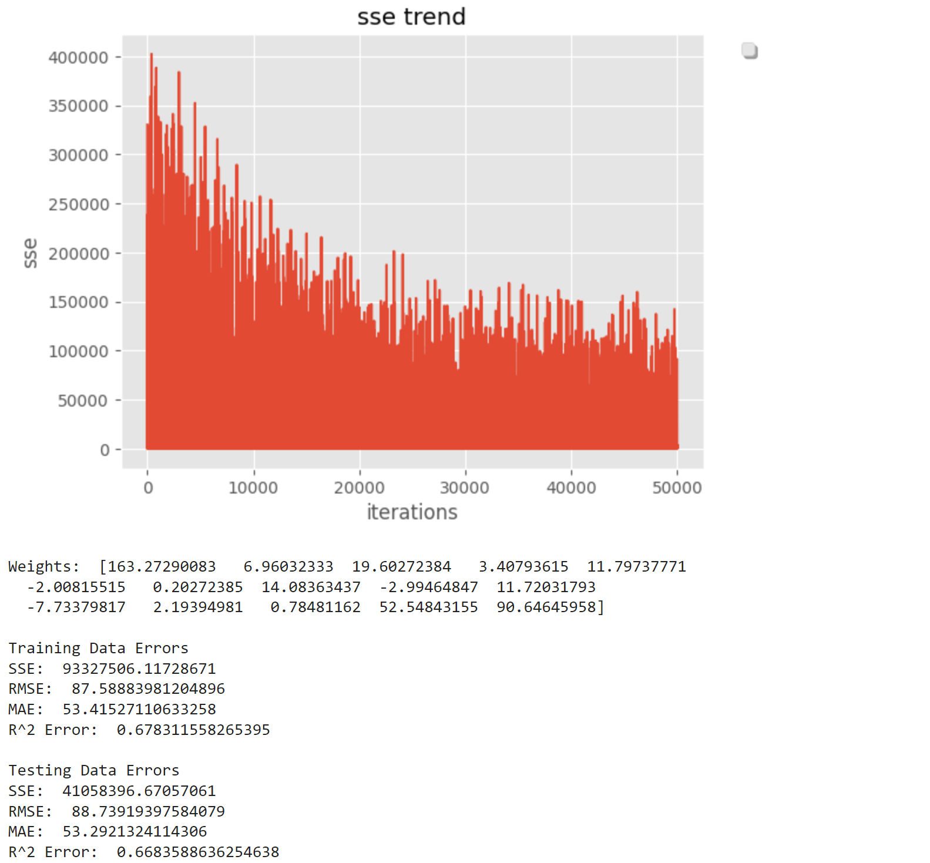
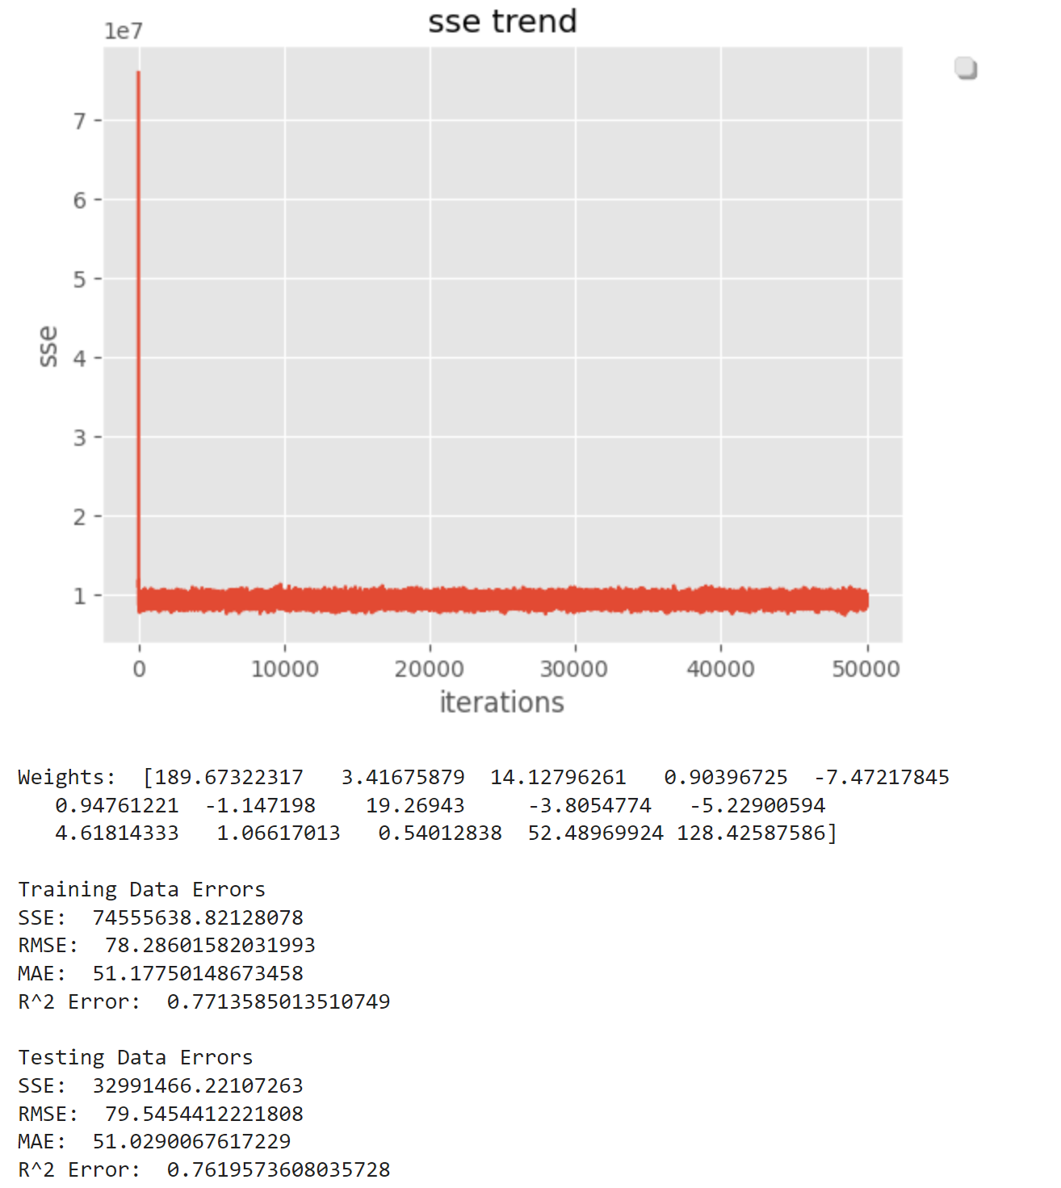
Gradient Descent

Slide 15
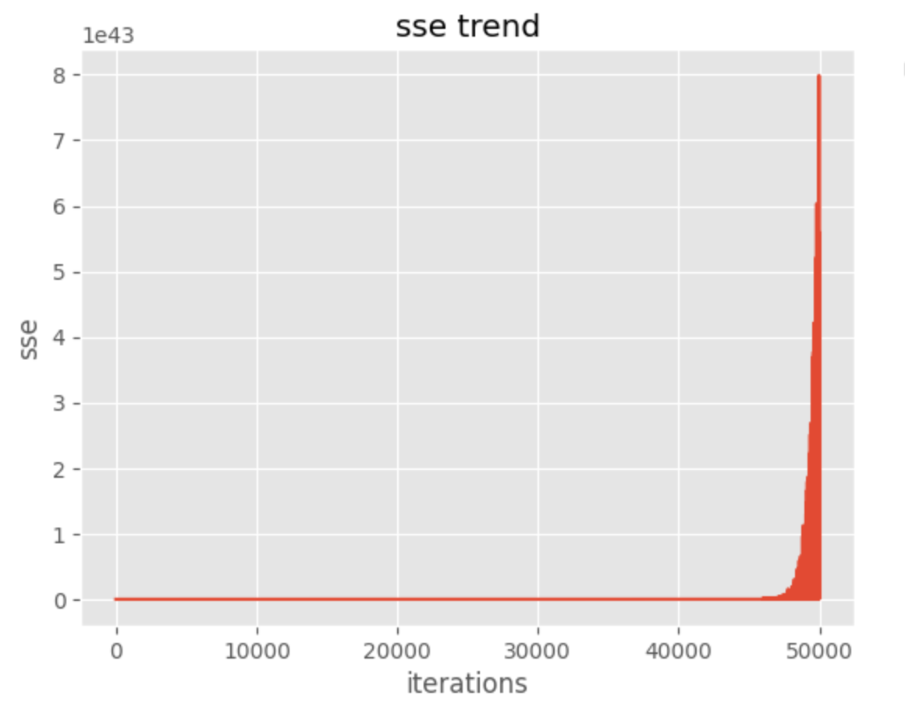
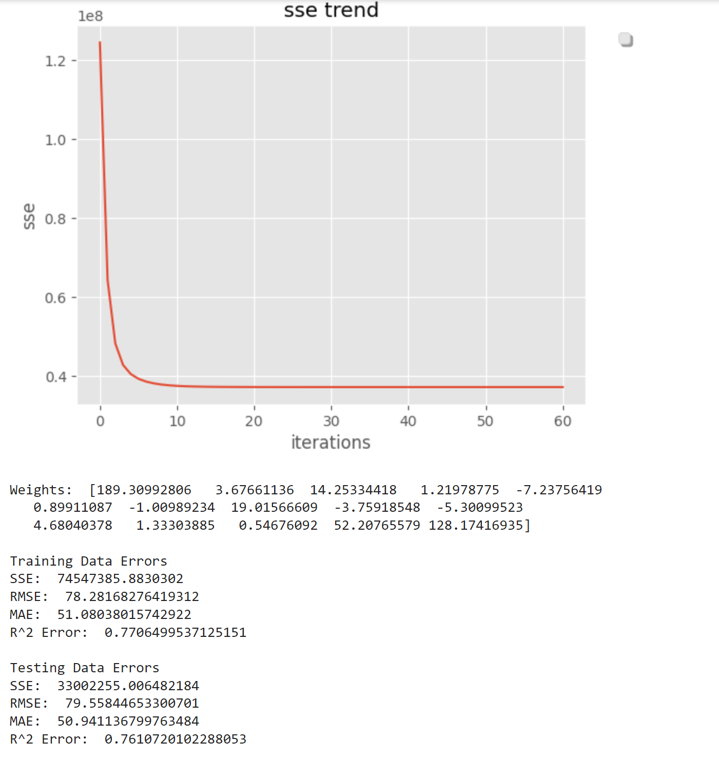
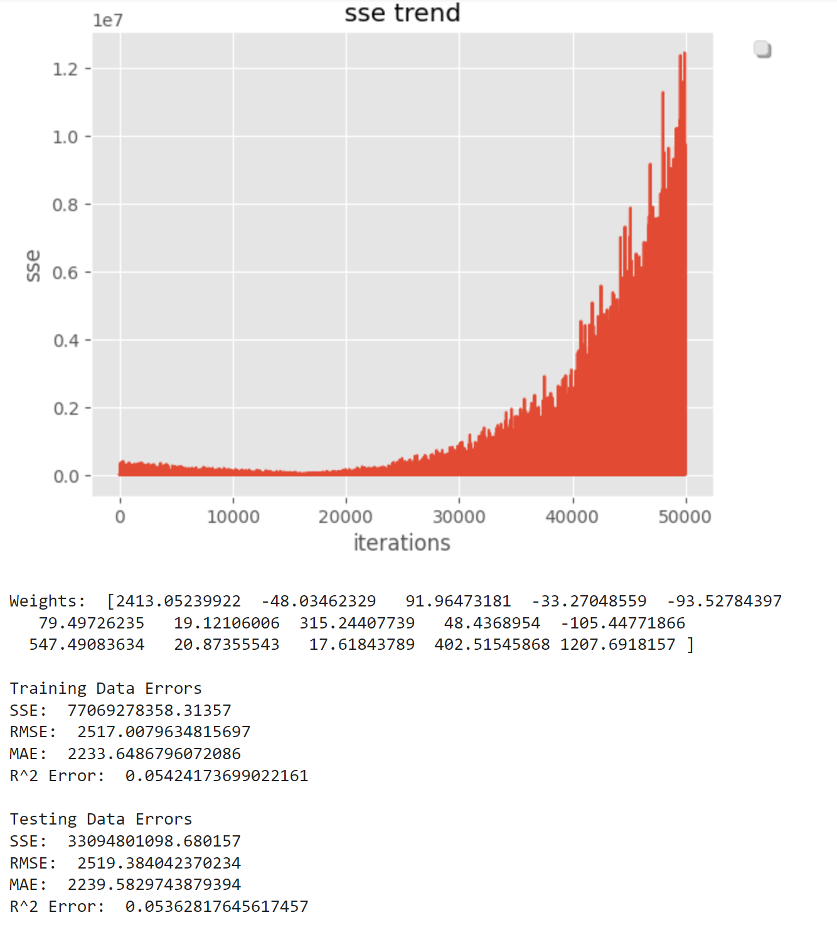
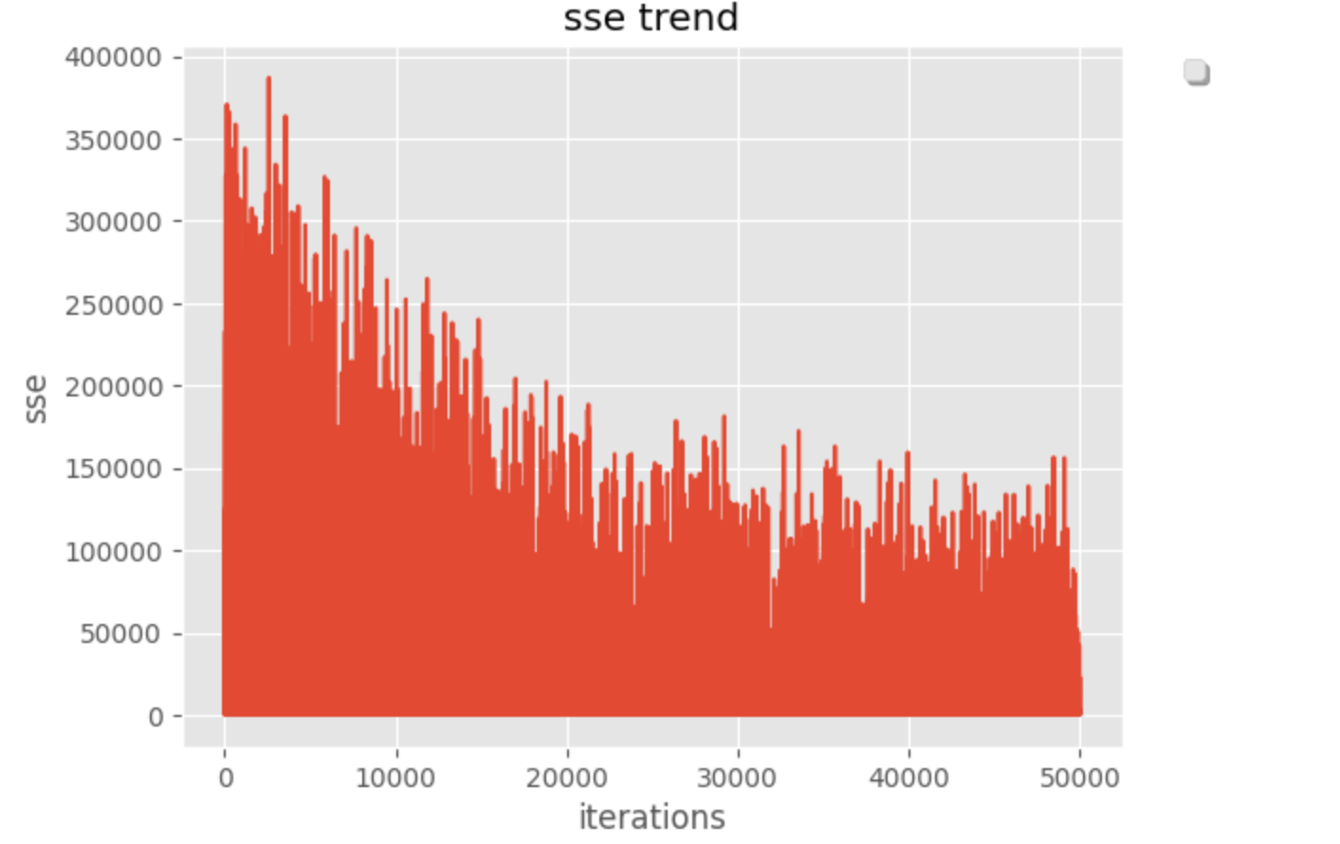
ADDING THE PENALTY
The technique is L2 regularization
Remove Multicollinearity and Avoid Overfitting
The aim is to decrease both inaccuracy and the number of coefficients.

Slide 16
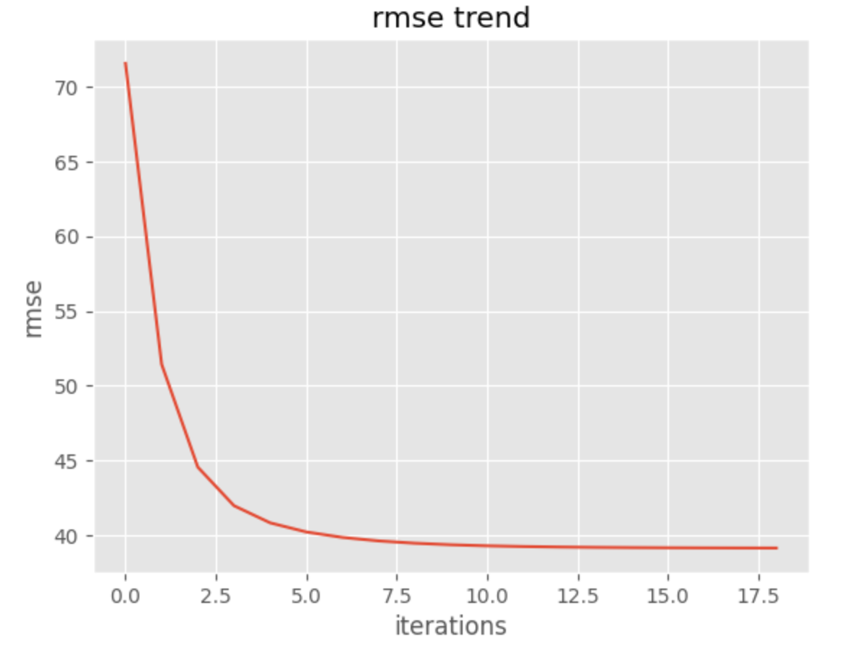
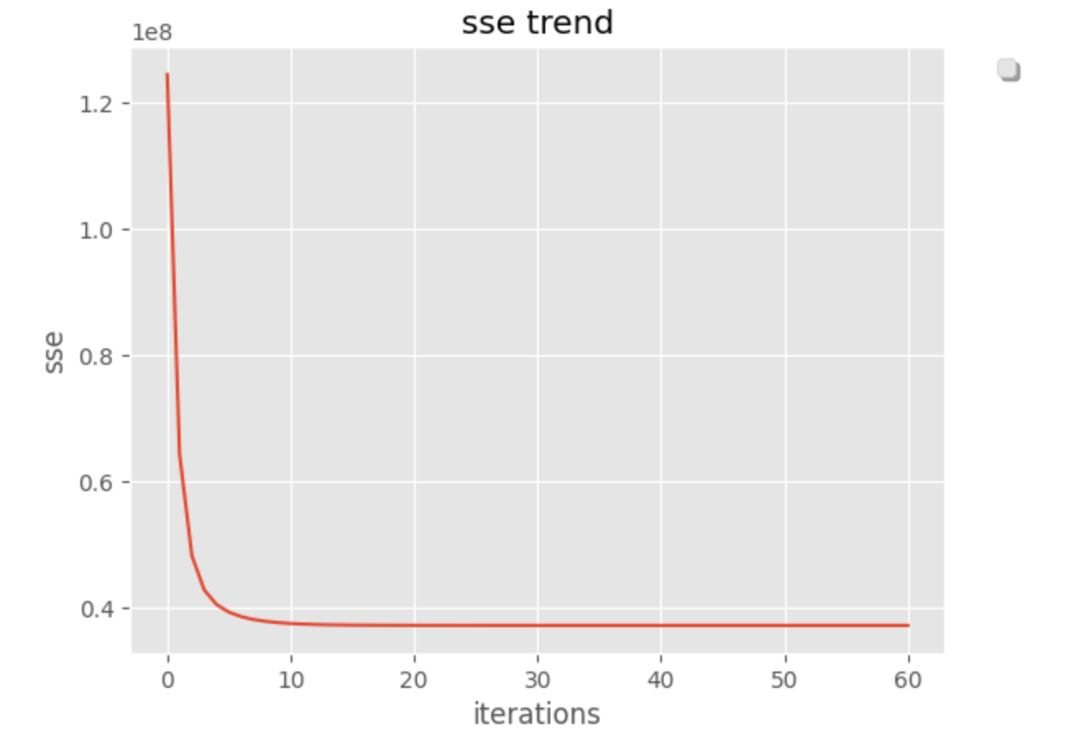
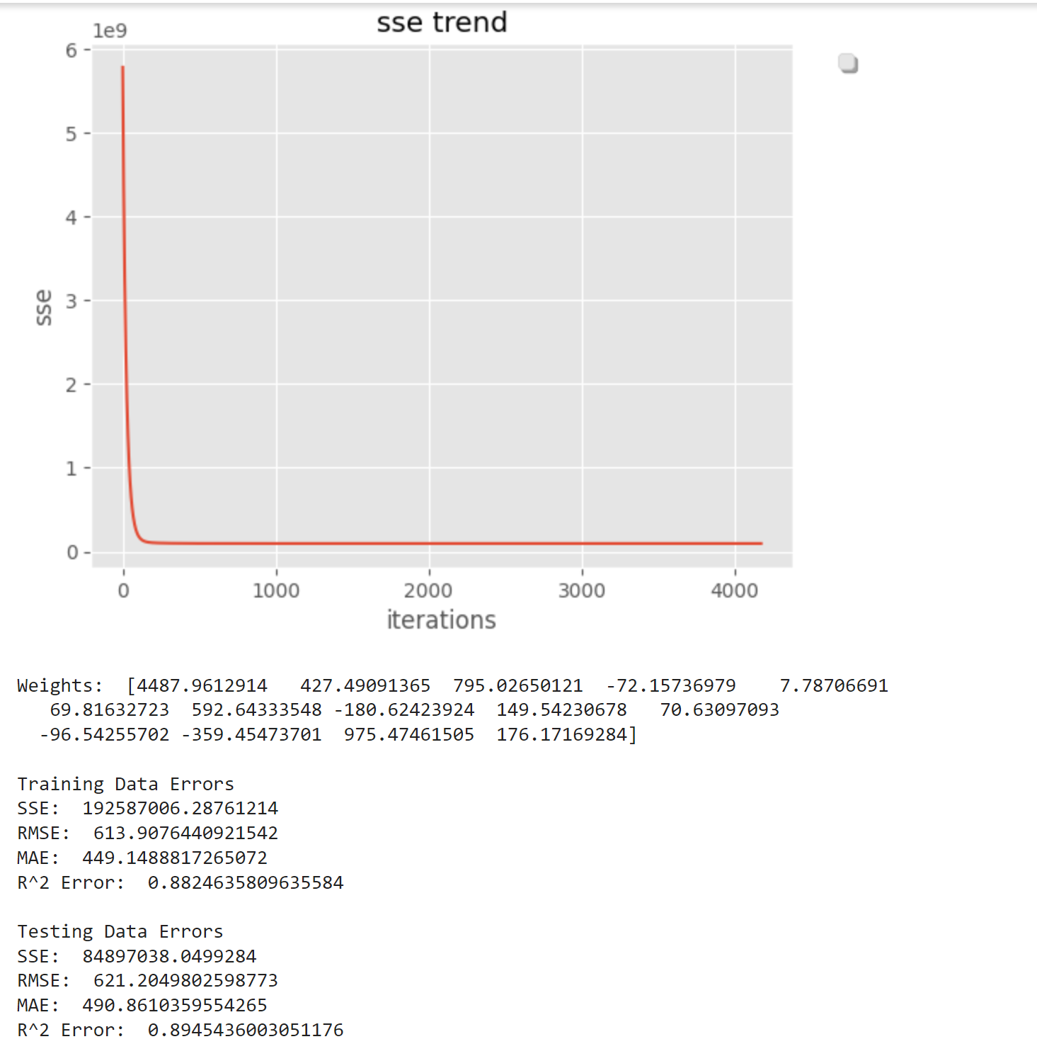
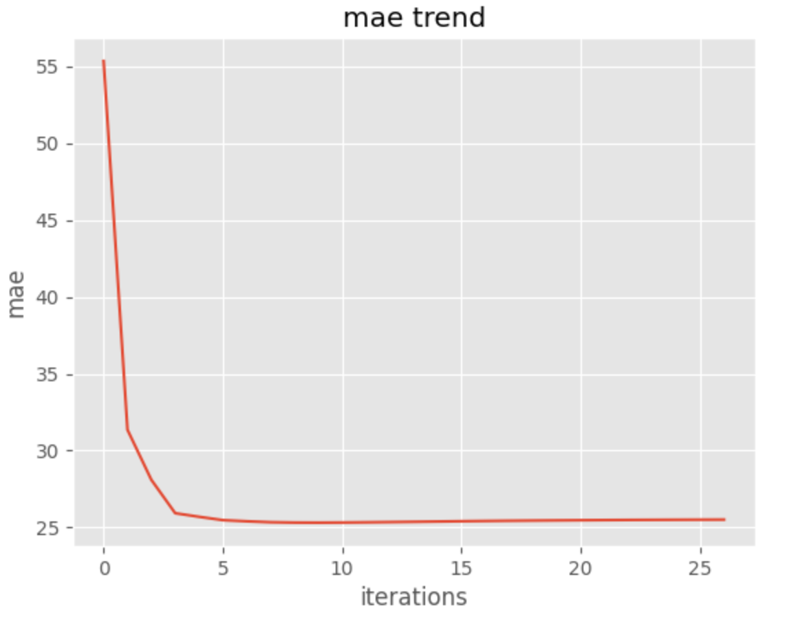
ADDITIONAL ALTERATIONS
Altering the Cost Function:
SSE vs MAE vs RMSE
RMSE shows significant reduction in convergence
Training the Model on daily rental data
Improved results could be due to less variance in the data which explains significant increase in R^2

Slide 17
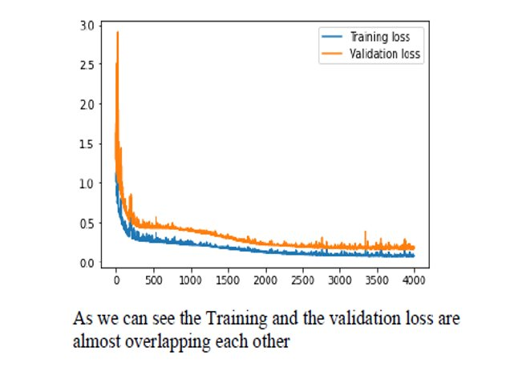
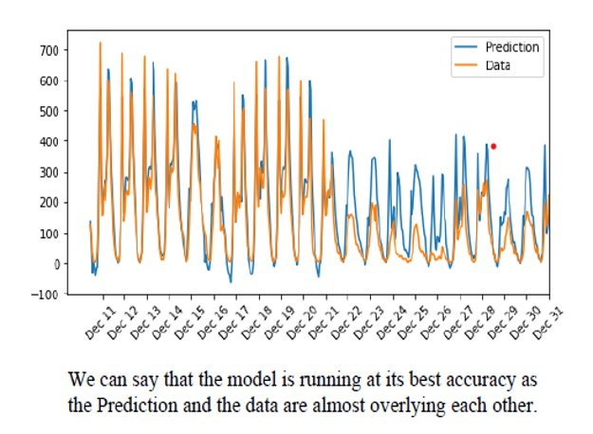
Neural Network:
Input layer: Information passed to the model​
Hidden layer: Group of neurons where calculations are done.​
Output layer: Result of the calculations where output node can be single or several nodes depending on the problem​
Error is determined after receiving the predictions​

Slide 18
Conclusion
After comparing the models mentioned above, it can be concluded that:
The Neural Network model is performing well in terms of prediction, as there are no signs of overfitting or underfitting.
Ridge regression includes a penalty term which helps to reduce over-fitting and ensures that a solution can be found.
Daily Data may be better suited for predicting bike rentals however less useful depending on granularity needed
Further parameter optimization may be required especially for the likes of Mini-Batch and Stochastic Gradient Descent

